Slide 1
The analytics opportunity identified
Currently, jobseekers are required to enter the job title and select their SSOC occupation from a dropdown list.
Analytics Opportunity:
Selecting SSOC occupation is viewed as a duplicate step
Removes the need for manual dropdown selection.
Improve user satisfaction by removing this duplicate step

Slide 2
Proposed solution to address the problem
Jobseekers would not need to manually pick SSOC codes.
SSOC occupation may be predicted automatically from the job title.
Jobseekers will be able to automatically view the “suggested SSOC occupation” once they enter job title.
Jobseekers will be given the option to manually override suggested SSOC occupation if deemed inaccurate.

Slide 3
Technical approach and considerations
Python to be used to clean data, analyze it and build a machine learning model.
Based on “job title” the machine learning model will predict and classify into the SSOC occupation.

Slide 4
Technical approach and considerations
STEP 1:
Job titles will first be converted to numbers (vectors) so that a machine learning model can understand
TfidfVectorizer is a tool that helps computers understand text by turning words into numbers
Advantages of TfidfVectorizer
Handles short texts (like job titles) well
Captures important, unique words
Makes text data compatible with machine learning models

Slide 5
Technical approach and considerations
STEP 2:
Machine learning classification model will be used to classify job titles to SSOC occupations
Machine learning Classification model selected
Logistic Regression
Considerations of Logistic Regression Model
Simple and Fast
Dataset is not huge
Other classification models may be deployed based on dataset size and accuracy results
Convolutional Neural Network (CNN) to be used for large datasets or titles with more words

Slide 6
Results and interpretations
Sample Size overview
Total samples: 2,359
Training data: 1,887 samples (80%)
Testing data: 472 samples (20%)
Model Accuracy
Training accuracy: 75%
Testing accuracy: 61%

Slide 7
Results and interpretations
Training accuracy: 75%
The model correctly predicted the output on 75% of the training data.
This indicates it learned patterns from the training set relatively well.
Testing accuracy: 61%
On unseen testing data, the model was only 61% accurate.
This is significantly lower than the training accuracy, suggesting that the model might be overfitting — i.e., it's performing well on training data but not generalizing well to new data.

Slide 8
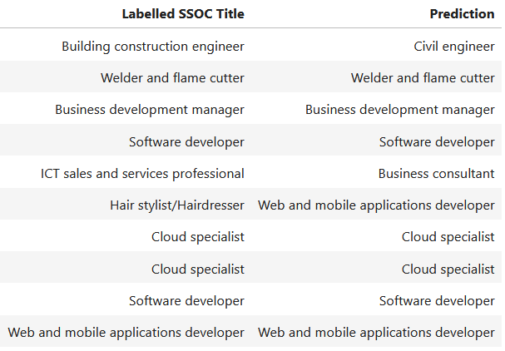
Test Result Analysis
‘Labelled SSOC Title’ and the ‘Prediction’ is compared side by side.
The first 10 rows of the findings is shown in Table 1.
We can observe mismatches in predictions.
Table 1: Test results (first 10 rows)

Slide 9
Test Result Analysis
Test results were filtered based on mismatches.
Mismatched test results were exported as a CSV file for further analysis.
Table 2 shows a snippet of the CSV file.
Some predictions performed more poorly than others.
Table 2: Mismatched test results

Slide 10
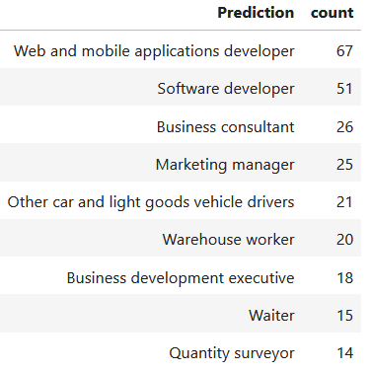
Test Result Analysis
Mismatched predictions were grouped to show counts
Counts with >10 mismatches were filtered
Table 3 shows all predictions where counts exceeded 10.
Web/mobile app developer and Software developers were worst performing in predicting.
Table 3: Mismatched test results in descending order

Slide 11
Technical challenges and possible ways to address them
Testing accuracy was only 61%.
The sample set provide was small. Test predictions could perform better with a larger training set.
Alternate classification models should be trained to evaluate accuracy. Better performing models should be used as a substitute.
Auto-suggestion by model may be inaccurate. Use a pre-trained model to return top 3 predictions enabling the users to confirm or override the model’s guess.

Slide 12
Things I would ask for to improve my solution
Historical logs of user-corrected dropdown selections, which reveal where the model predicts incorrectly.
This would help improve the model’s performance and reduce misclassification.

Slide 13

Things I would ask for to improve my solution
Certain SSOC occupations appeared only once in the dataset. This affects predictability of model.
Table 4 shows the number of times each SSOC occupation appeared in the dataset.
142 SSOC occupations appeared only once.
More data is required to improve performance of the model.
Examples:
Library clerk
Maintenance planner
Marine superintendent, etc
Table 4: SSOC counts highlighting lack of sufficient data

